Slide 1
Reactive forms
What is reactive forms ?
Pros and cons of reactive forms.
High-level Differences between Template-driven and Reactive Forms
Set up Module to use Reactive Forms.
Real world example.
Control value accessor.
Testing using reactive forms.
References

Slide 2
What is reactive forms ?
Reactive form controls is very easy to use and maintain additionally very easy to test and we can generate more powerful dynamic forms.
When the angular component has multiple props and function in one component is very hard to maintain. In [(ngModel)] forms we need to maintain each field and it's state separately, but reactive form gives power to organised all controls together. It follows SOLID principle very nicely. It also have some inbuilt validator and allowed us to write our custom validator

Slide 3
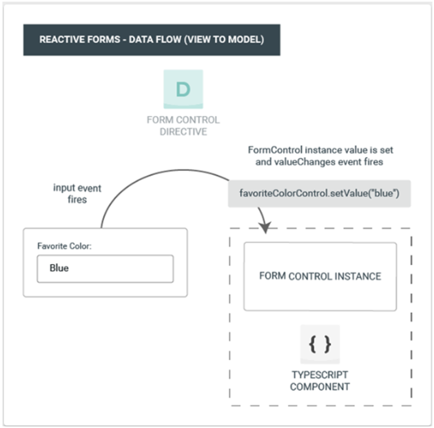
What is reactive forms ?

Slide 4
2. Pros and cons of reactive forms
Positive | Negative
Using we can build dynamic forms very easily | It add some extra code in .ts file
We can use batter single responsibility principle | It need’s bit high level understanding of angular
Can build very complex forms easily | Need extra import of Reactive Forms Module
Can build custom validator very easily
Reduce code in complex scenario where we need to use multiple state and related field value validation.
Avoid repetition logic

Slide 5
3. High-level Differences between Template-driven and Reactive Forms
Template-driven | Reactive Forms
Template-driven forms make use of the "FormsModule" | reactive forms are based on "ReactiveFormsModule
Template-driven forms are asynchronous in nature | Reactive forms are mostly synchronous.
In a template-driven approach, most of the logic is driven from the template | whereas in reactive-driven approach, the logic resides mainly in the component or typescript code

Slide 6
4. Set up Module to use Reactive Forms.

Slide 7
5. References .
https://angular.io/guide/reactive-forms
https://angular.io/api/forms/ControlValueAccessor
https://github.com/skuchhadiya/ReactiveFormsDemo

